Slide 1
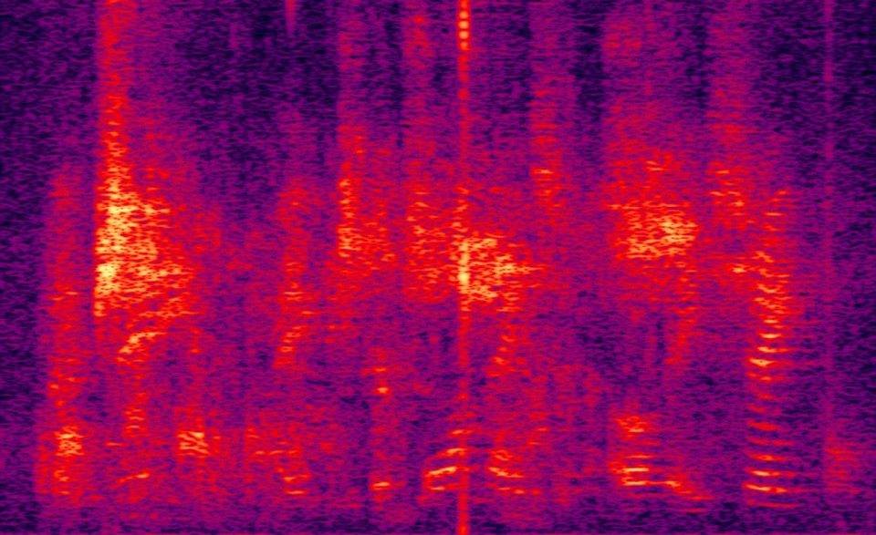
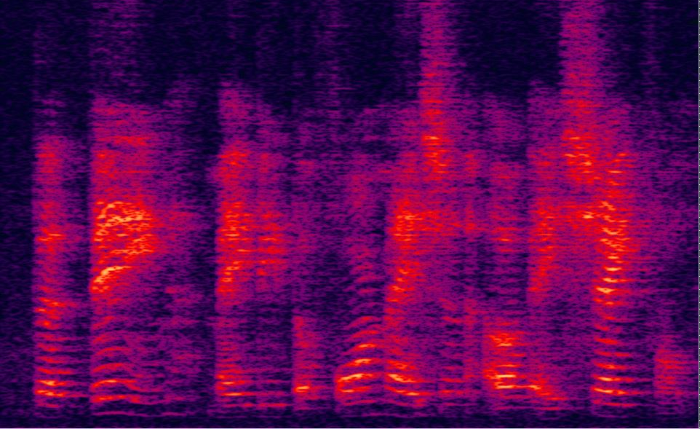
Real-time Residual Echo Suppression with Deep Learning
Amir Ivry, IEEE Student Member
Prof. Israel Cohen, Fellow, IEEE
Dr. Baruch Berdugo

Slide 2
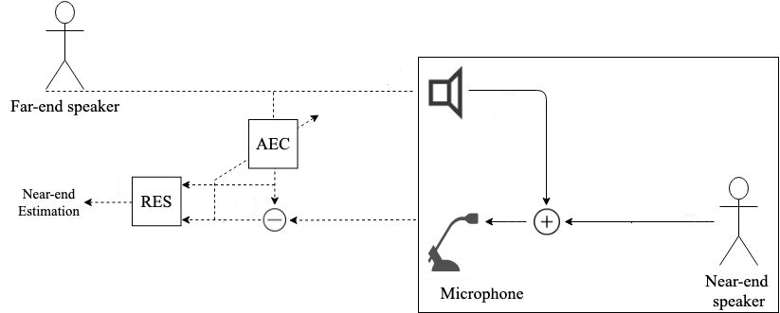
Traditional System Setup & Problem Formulation

Slide 3
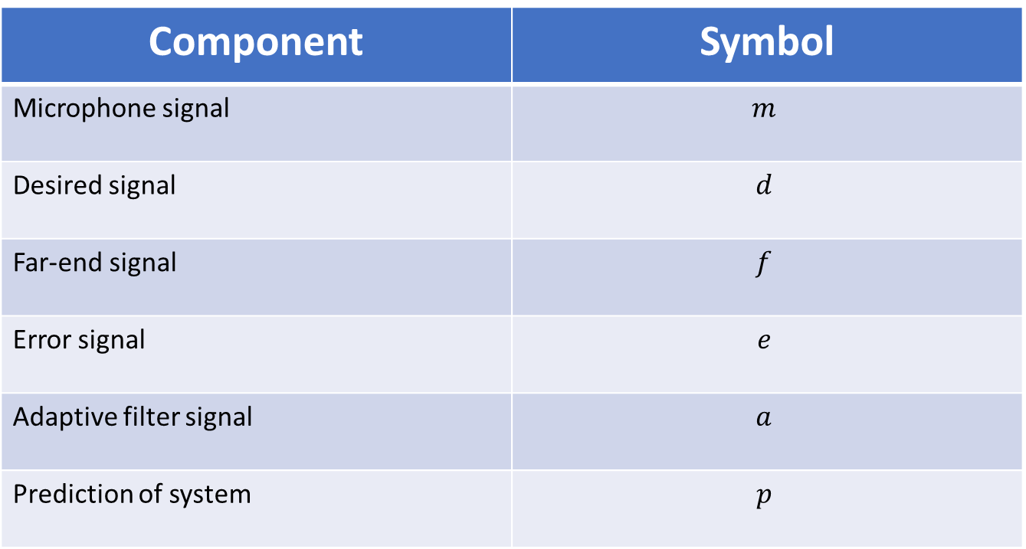
System Components
Component | Symbol
Microphone signal | $$m$$
Desired signal | $$d$$
Far-end signal | $$f$$
Error signal | $$e$$
Adaptive filter signal | $$a$$
Prediction of system | $$p$$

Slide 4

Traditional System Setup & Problem Formulation

Slide 5

The Challenge
Double-talk scenarios
(full-duplex)
Acoustic echo cancellers (AECs) only reduce linear echo
Residual echo suppression (RES) systems are not real-time

Slide 6
Proposed Solution
FC DNN for error-to-target mapping
Efficient resources of latency & volume
Transfer learning and design parameter

Slide 7
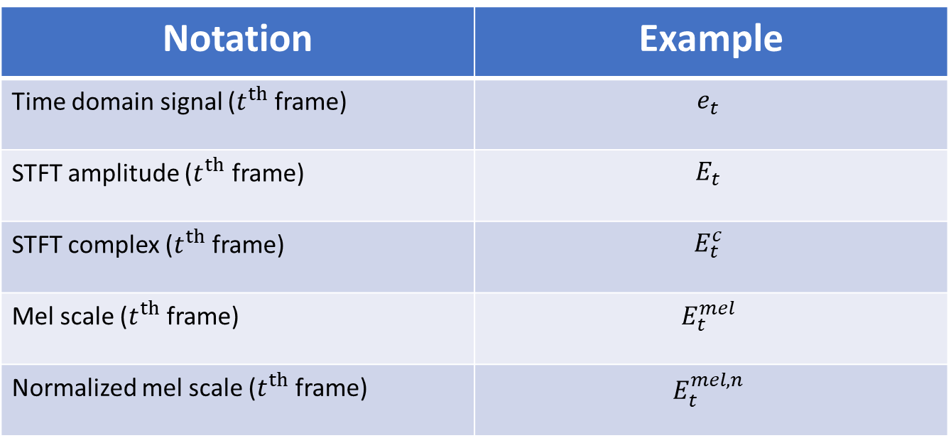
Important Notations
Notation | Example
Time domain signal ($t^{th}$ frame) | $$e_{t}$$
STFT amplitude ($t^{th}$ frame) | $$E_{t}$$
STFT complex ($t^{th}$ frame) | $$E_{t}^{c}$$
Mel scale ($t^{th}$ frame) | $$E_{t}^{mel}$$
Normalized mel scale ($t^{th}$ frame) | $$E_{t}^{mel,n}$$

Slide 8
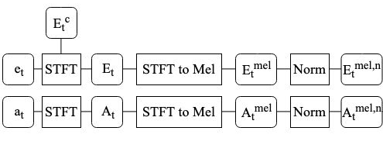
System Architecture (Analysis)
32ms
257 bins
64 bins
64 bins

Slide 9
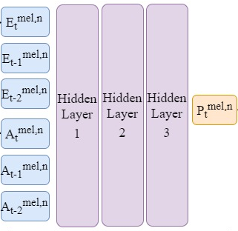






System Architecture (Neural Network)
Optimization (Adam) for:
$$J\left(α,β\right)=\frac{1}{64}\left[ℓ_{2}^{2}\left(P−D\right)+αℓ_{2}^{2}\left(P\right)\right]+βσ^{2}\left(P\right)$$
$$64×6$$
$$750$$
$$750$$
$$750$$
$$64$$

Slide 10
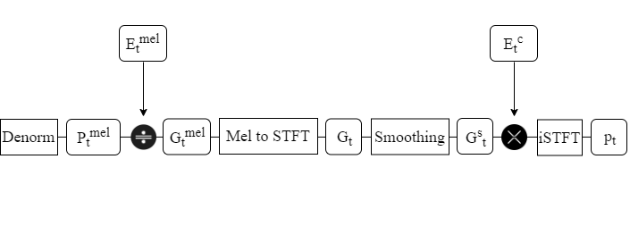





System Architecture (Synthesis)
$64$ bins
$64$ bins
$257$ bins
$257$ bins
$$32ms$$

Slide 11
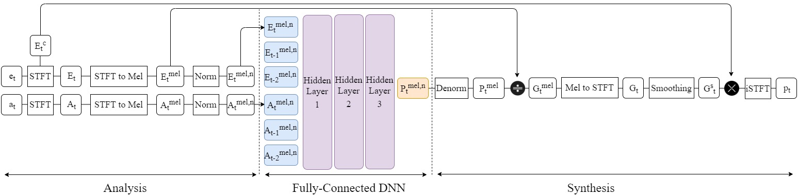
System Architecture (End-to-end)

Slide 12
Performance Measures
Current measures account for joint effect of AEC and RES
Construct RES as gain and isolate its effect
Calculate desired signal distortion & residual echo suppression independently

Slide 13
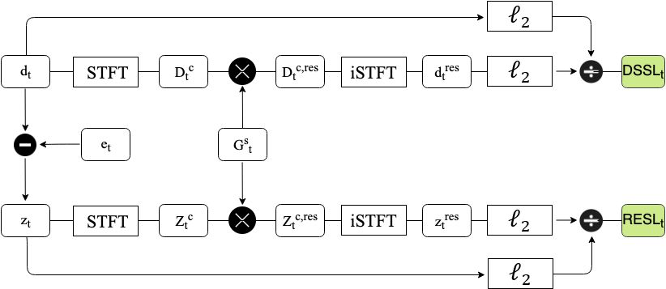
Performance Measures

Slide 14
Real-data Experiments
Mouth simulator (Bruel & Kjaer)
Speaker-phone (Phoenix Audio)
External speaker (Logitech)

Slide 15
Results
Different setup
Different dataset
Transfer learning

Slide 16
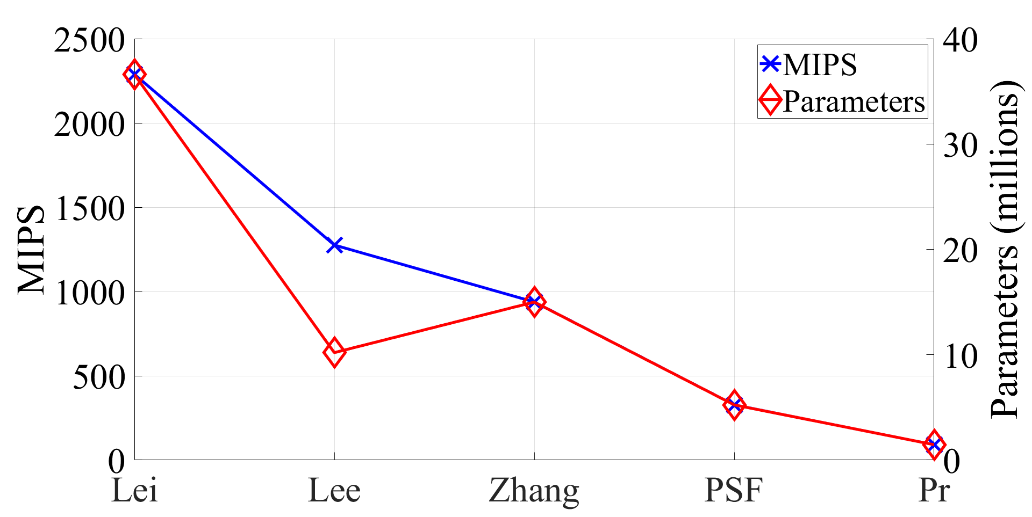
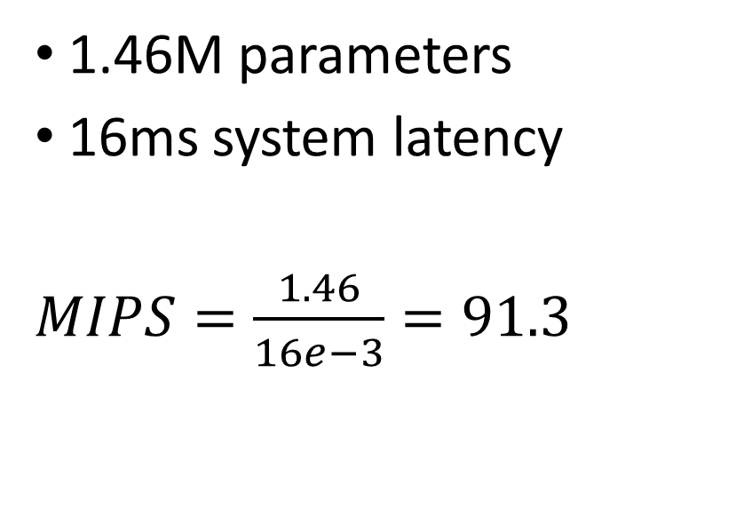
Real-time Implementation
1.46M parameters
16ms system latency
$MIPS=\frac{1.46}{16e−3}=91.3$

Slide 17
Information and Contact
LinkedIn & Google Scholar | E-mail | Publication
Amir Ivry | amirivry@gmail.com | Real-time Residual Echo Suppression with Deep Learning

Slide 18
